Slide 1
Geometry Shader (GLSL)
Add/remove primitives
Add/remove vertices
Edit vertex position
Spring 2010
1

Slide 2
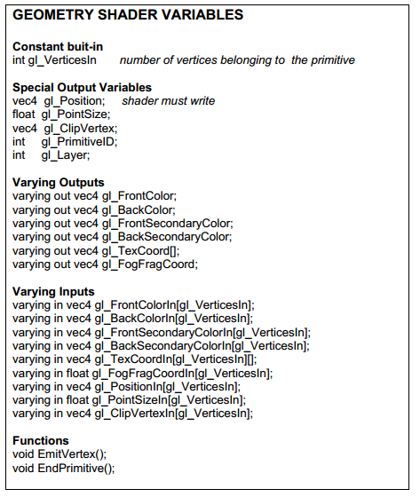
Quick
Reference
(url)
Spring 2010

Slide 3
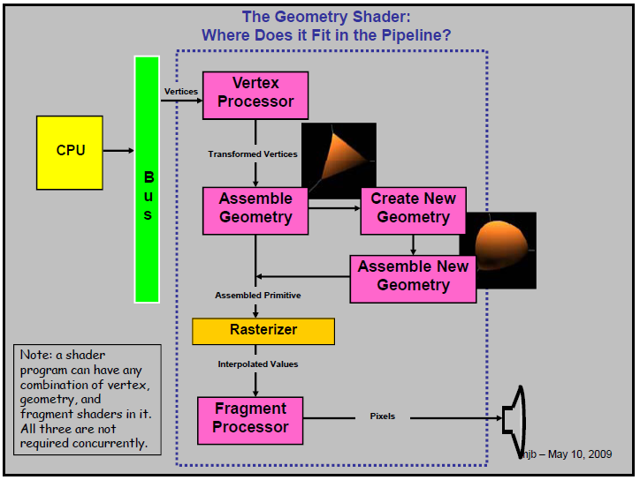
Overview
Spring 2010

Slide 4
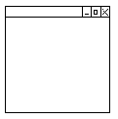
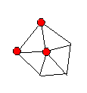
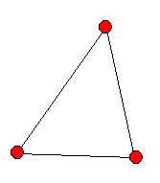
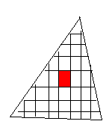

Pipeline
(x,y,z)
(x’,y’,z’)
attribute
Vertex
Shader
rasterizer
Fragment
Shader
Buffer Op…
varying
varying
uniform
(x,y,z)
attribute
Vertex
Shader
Geometry
Shader
rasterizer
Fragment
Shader
varying in
varying out
uniform
Spring 2010

Slide 5
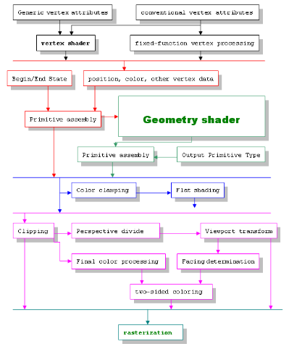
Pipeline
Spring 2010

Slide 6
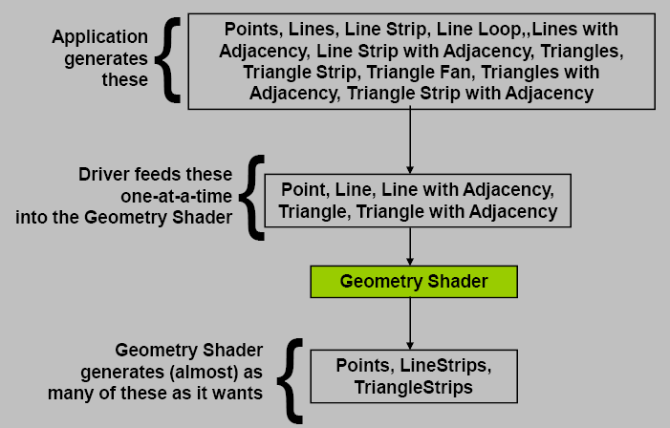
Input/Output
Spring 2010

Slide 7
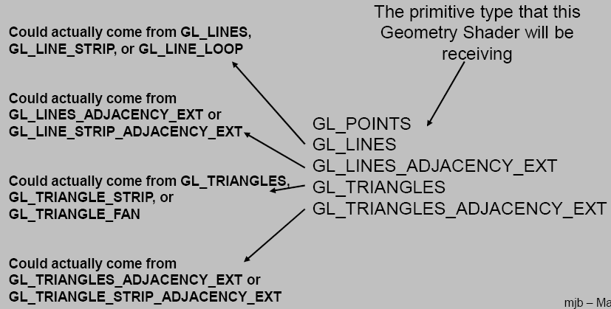
Setting Input Type
Later…
Spring 2010

Slide 8
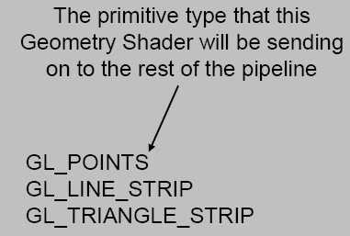
Setting Output Type
Spring 2010

Slide 9



Setting Max Output Vertices
Since you may not emit an unbounded number of points from a geometry shader, you are required to let OpenGL know the maximum number of points any instance of the shader will emit. Set this parameter after creating the program, but before linking.
Query functions
Spring 2010

Slide 10
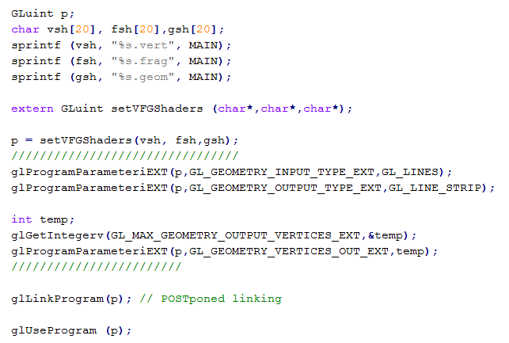
Thus,
Shaders compiled and attached
Spring 2010

Slide 11
Remarks
It is an error to attach a geometry shader to a program without attaching a vertex shader.
It is an error to use a geometry shader without specifying GL_GEOMETRY_VERTICES_OUT_EXT.
The shader will not compile correctly without the #version and #extension pragmas.
In general, you must specify the type of the primitives input and output to and from the geometry shader. These need not necessarily be the same type. By default, this is set to GL_TRIANGLES. Forgetting to set this parameter may result in a black screen.
Spring 2010

Slide 12
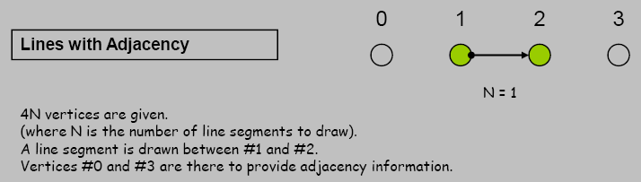
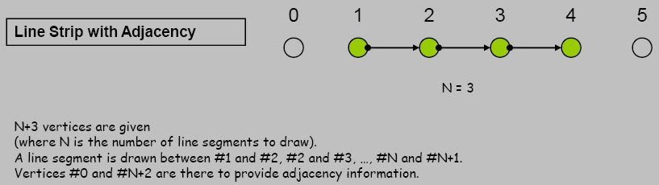
New (input) Adjacency Primitives
Spring 2010

Slide 13
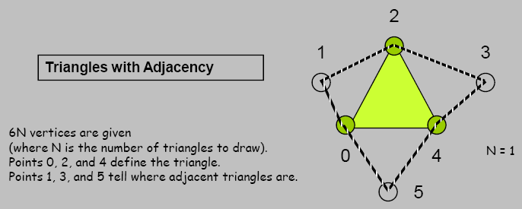
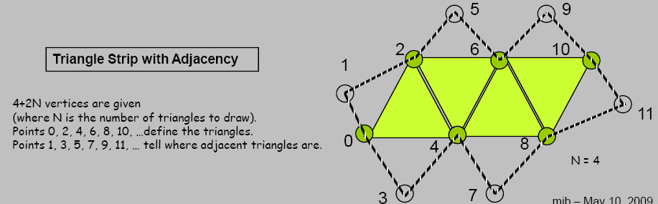
New (input) Adjacency Primitives
Spring 2010

Slide 14
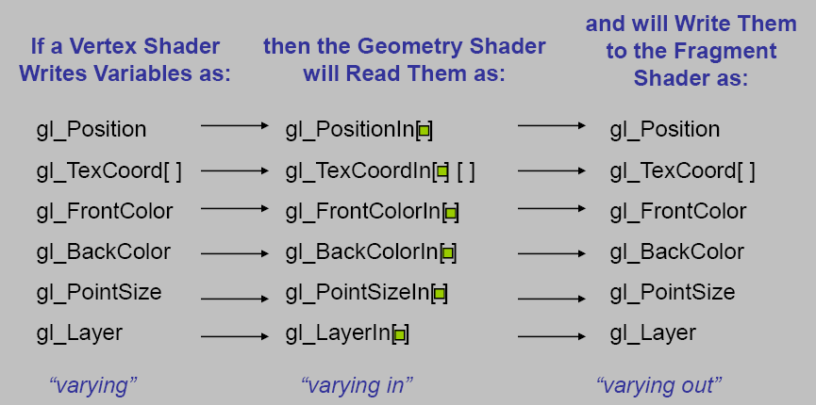

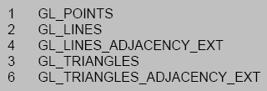
Varying …
Spring 2010

Slide 15
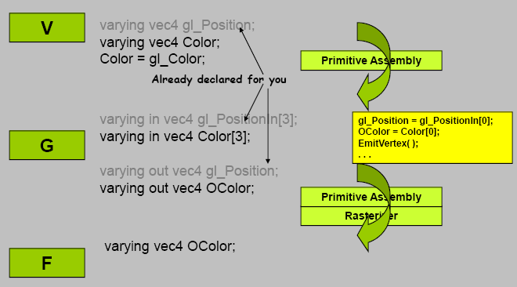
Spring 2010

Slide 16
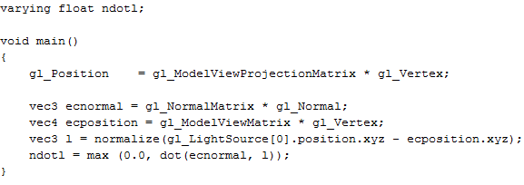
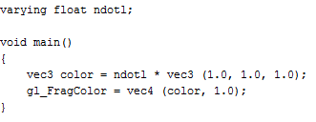
Gouraud
(vertex+fragment)
Spring 2010

Slide 17
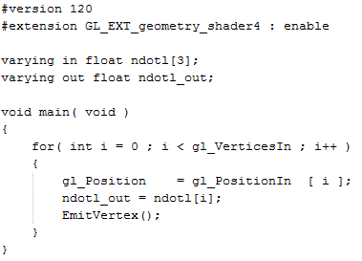
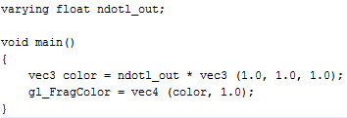
Gouraud (vertex+geometry+fragment)
Spring 2010

Slide 18
Phong
(vertex+fragment)
Spring 2010

Slide 19
Phong (vertex+geometry+fragment)
Spring 2010

Slide 20
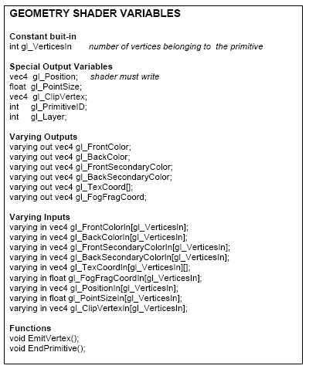
Built-In
Variables
Spring 2010

Slide 21
Details
When the Geometry Shader calls EmitVertex( ), this set of variables is copied to a slot in the shader’s Primitive Assembly step
When the Geometry Shader calls EndPrimitive( ), the vertices that have been saved in the Primitive Assembly step are then assembled, rasterized, etc
Notes
  there is no “BeginPrimitive( )” routine. It is implied by (1) the start of the Geometry Shader, or (2) returning from the EndPrimitive( ) call.
  there is no need to call EndPrimitive( ) at the end of the Geometry Shader – it is implied.
Spring 2010

Slide 22
Sample Codes
Spring 2010

Slide 23
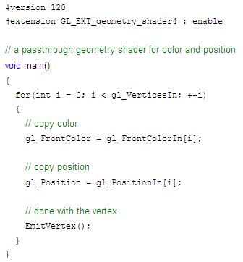
Passthrough
Spring 2010

Slide 24
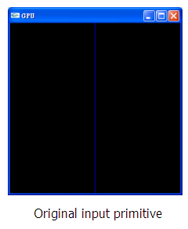
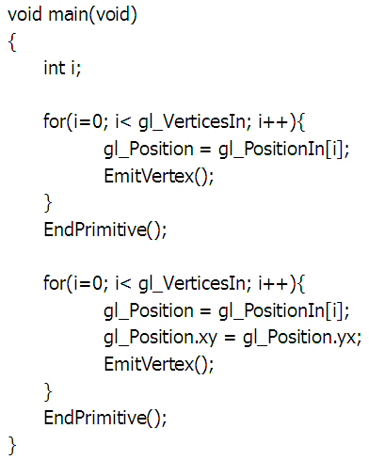
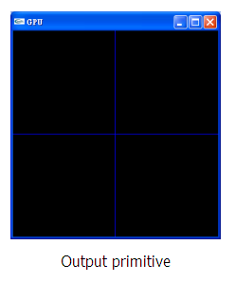
Line+Line
I have a slightly
different viewer
implementation
Spring 2010

Slide 25
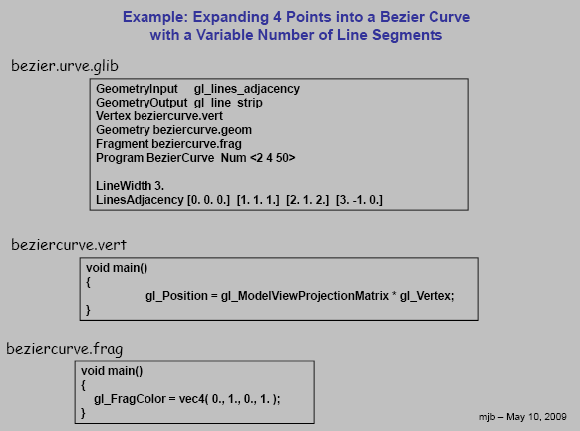
Bezier Curve
Spring 2010

Slide 26
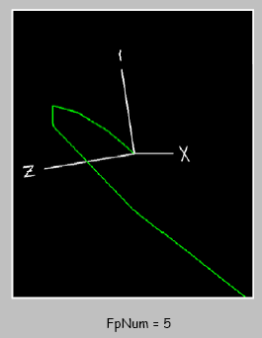
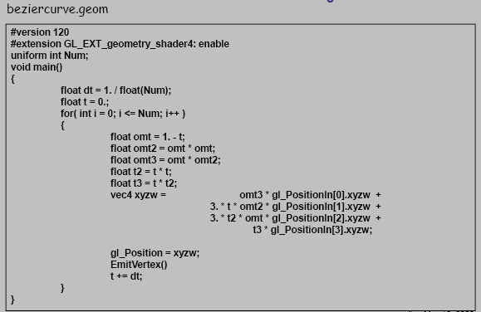
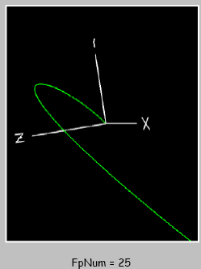
Bezier Curve
Spring 2010

Slide 27
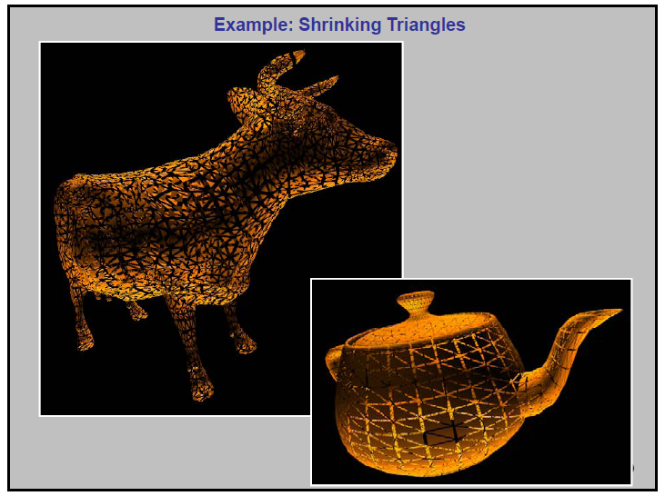
Shrinking Triangles
Spring 2010

Slide 28
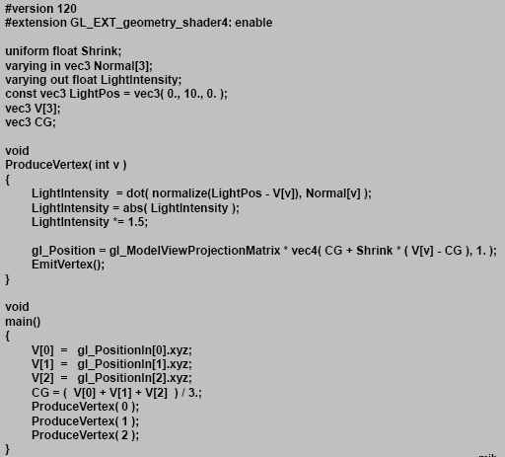
Shrinking Triangles
Spring 2010

Slide 29
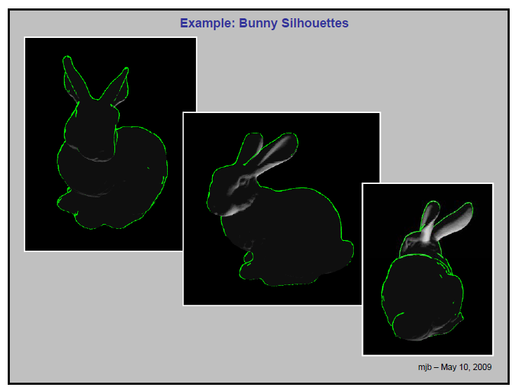
Silhouette
Spring 2010

Slide 30
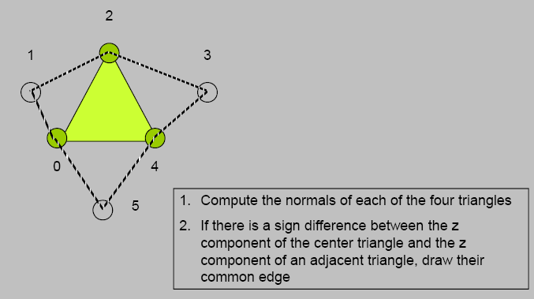
Input: gl_triangle_adjacency
Output: gl_line_strip
Spring 2010

Slide 31
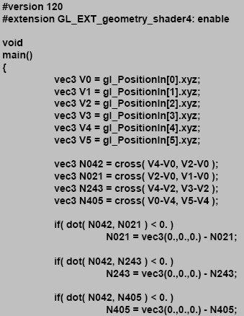
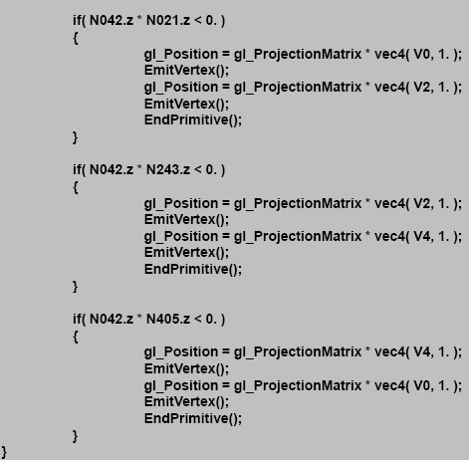
Spring 2010

Slide 32
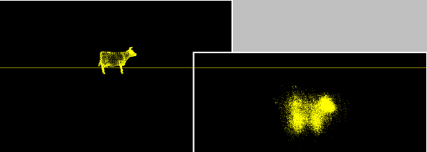
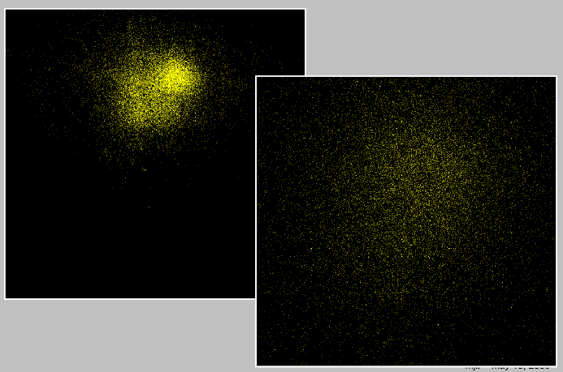
Explosion
Spring 2010

Slide 33
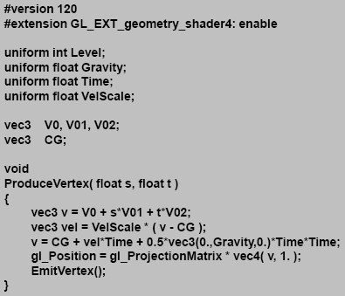
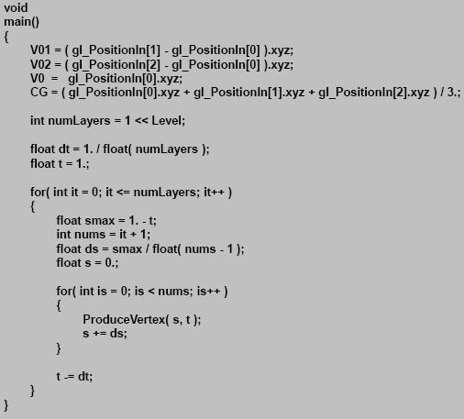
Explosion
Spring 2010

Slide 34
More Applications
Spring 2010

Slide 35

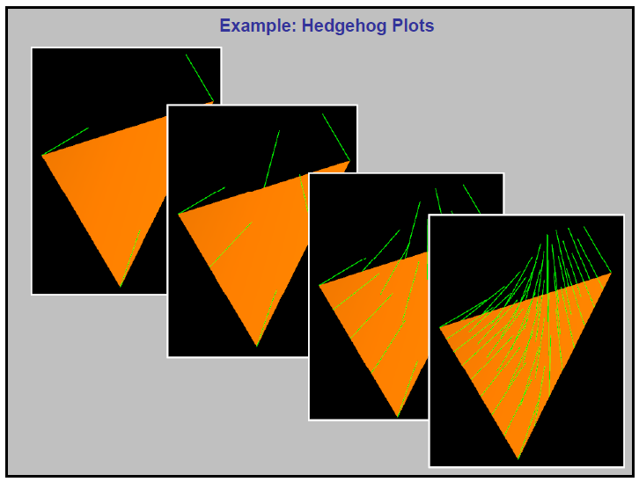
Hedgehog Plots
Spring 2010

Slide 36
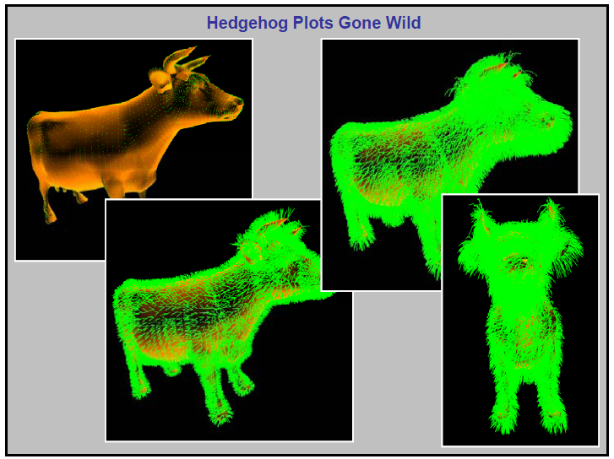
Hedgehog Plots
Spring 2010

Slide 37
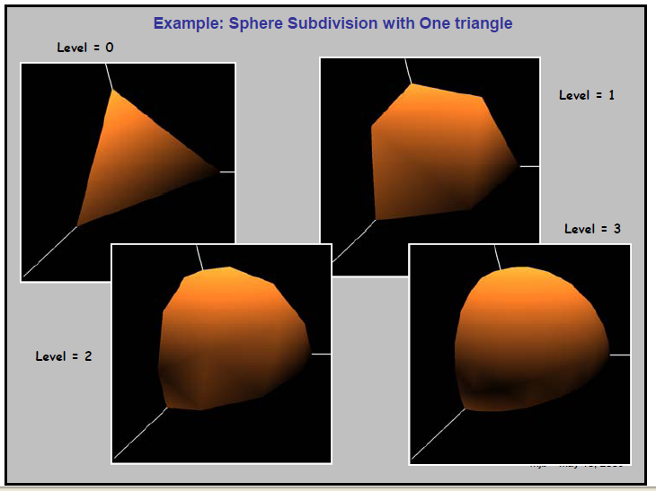
Subdivision Surface
Spring 2010

Slide 38
References
http://web.engr.oregonstate.edu/~mjb/cs519/Handouts/geometry_shader.pdf
Spring 2010

